Slide 1
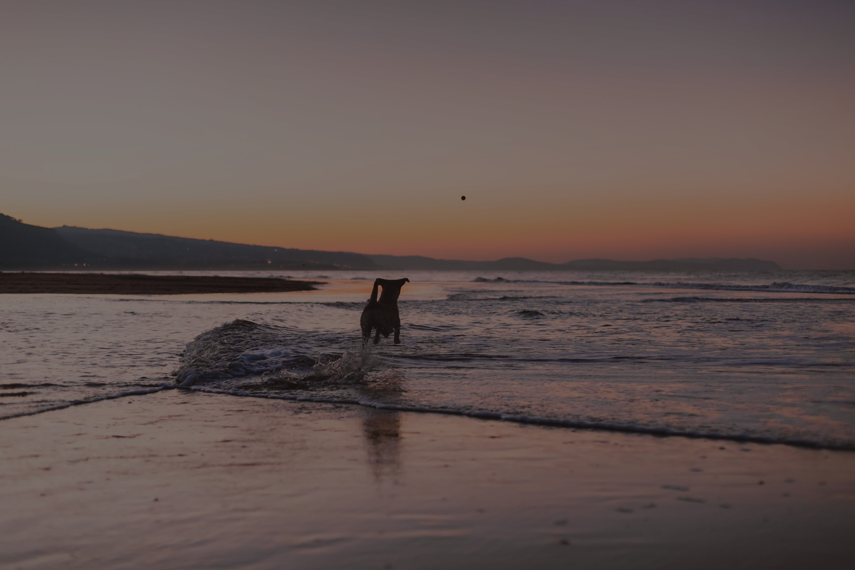
Pesky Pooch

Slide 2
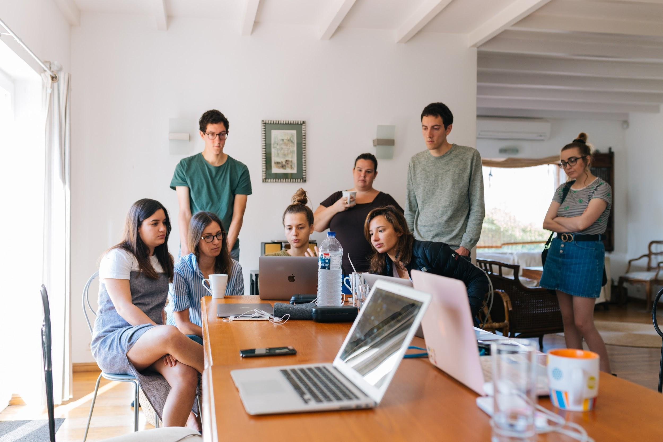
The Team
Team Member 1 - Coen Drexler
Team Member 2 - Dale Paulsen
Team Member 3 - Nick Fletcher

Slide 3
The Problem
Problems
No online presence

Slide 4
Challenges
Some of the challenges that we faced during this project include…
Cypress
Mocha and Chai
Task delegation
Agile management

Slide 5

What happens next?
Future updates
We will continue to support the client and web page with future updates and keeping it user friendly.

Slide 6

Live Demo
(Link to deployed site)

Slide 7
Fin

